Slide 1

Web and Cloud Security
Department of Economic Informatics and Cybernetics
Bucharest University of Economic Studies
ASP.NET – Part III
Liviu-Adrian Cotfas, PhD.
liviu.cotfas@ase.ro

Slide 2

ASP.NET MVC Core, C# Language
url: https://docs.microsoft.com/en-us/aspnet/
C#

Slide 3

About me
https://ro.linkedin.com/in/cotfasliviu

Slide 4
Administrative issues
Recommended Reading / Watching
Pro ASP.NET Core 3
ADAM FREEMAN
Now in its 8th edition, the best-selling book on MVC is now updated for ASP.NET Core.
https://www.apress.com/gp/book/9781484254394
https://github.com/Apress/pro-asp.net-core-3
Notes:
https://www.apress.com/gp/book/9781484252833

Slide 5

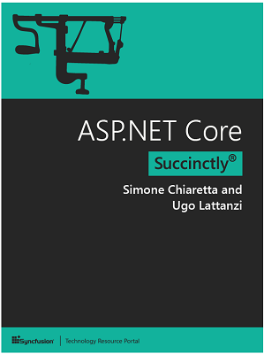
Administrative issues
Recommended Reading / Watching
ASP.NET Core Succinctly (Free)
Simone Chiaretta and Ugo Lattanzi
In ASP.NET Core Succinctly, seasoned authors Simone Chiaretta and Ugo Lattanzi update you on all the advances provided by Microsoft’s landmark framework.
https://www.syncfusion.com/resources/techportal/details/ebooks/ASP_NET_Core_Succinctly

Slide 6
Administrative issues
Further Reading / Watching
Courses on Microsoft Learn - https://docs.microsoft.com/en-us/learn/
Free
Courses on PluralSight - www.pluralsight.com
Free trial (10 days)
Free limited access through https://azure.microsoft.com/en-us/free/students/

Slide 7
Administrative issues
API reference and Source code
Documentation:
https://docs.microsoft.com/en-us/aspnet/
API reference:
https://docs.microsoft.com/en-us/dotnet/api/?view=net-5.0
Source code:
https://github.com/aspnet/Home
Various samples:
https://code.msdn.microsoft.com/

Slide 8
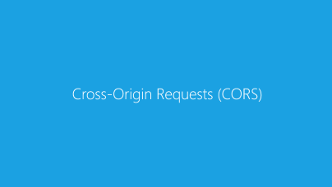
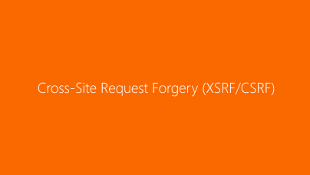
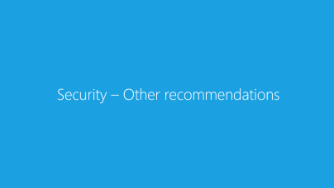
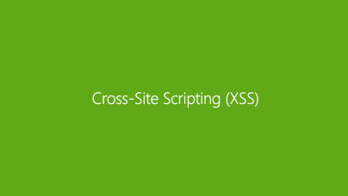
Contents

Slide 9
Security in ASP.NET Core
ASP.NET Core enables developers to easily configure and manage security for their apps. ASP.NET Core contains features for managing authentication, authorization, data protection, SSL enforcement, app secrets, anti-request forgery protection, and CORS management. These security features allow you to build robust yet secure ASP.NET Core apps.
Further reading: https://docs.microsoft.com/en-us/aspnet/core/security

Slide 10
Cross-Site Request Forgery (XSRF/CSRF)

Slide 11
Cross-Site Request Forgery (XSRF/CSRF)
Cross-site request forgery (also known as XSRF or CSRF, pronounced see-surf) is an attack against web-hosted applications whereby a malicious web site can influence the interaction between a client browser and a web site that trusts that browser.
These attacks are made possible because web browsers send some types of authentication tokens automatically with every request to a web site. This form of exploit is also known as a one-click attack or as session riding, because the attack takes advantage of the user's previously authenticated session.
A malicious site sends POST/GET requests to the attacked site (in which the user is authenticated).
Notes:
https://docs.microsoft.com/en-us/aspnet/core/security/anti-request-forgery

Slide 12
Cross-Site Request Forgery (XSRF/CSRF)
An example of a CSRF attack
A user logs into www.example.com, using forms authentication.
The server authenticates the user and issues a response that includes an authentication cookie.
The user visits a malicious site.
This malicious site contains the following HTML form:
Note: the form action posts to the vulnerable site, not to the malicious site. This is the “cross-site” part of CSRF.
<h1>You Are a Winner!</h1>
<form action="http://example.com/api/account" method="post">
<input type="hidden" name=“Account" value=“RO85INGXXXX" />
<input type="hidden" name="Amount" value="1000000" />
<input type="submit" value="Click Me"/>
</form>
Notes:
https://docs.microsoft.com/en-us/aspnet/core/security/anti-request-forgery

Slide 13
Cross-Site Request Forgery (XSRF/CSRF)
An example of a CSRF attack
The user clicks the submit button. The browser automatically includes the authentication cookie for the requested domain (the vulnerable site in this case) with the request.
The request runs on the server with the user’s authentication context, and can do anything that an authenticated user is allowed to do.
Although this example requires the user to click the form button, the malicious page could just as easily run a script that automatically submits the form or sends a form submission as an AJAX request. The form could also be hidden using CSS so the user never realizes it's present. Moreover, using SSL does not prevent a CSRF attack, because the malicious site can send an https:// request. Some attacks can target site endpoints that respond to GET requests, in which case even an image tag can be used to perform the action.
Notes:
https://docs.microsoft.com/en-us/aspnet/core/security/anti-request-forgery

Slide 14
Cross-Site Request Forgery (XSRF/CSRF)
An example of a CSRF attack
Typically, CSRF attacks are possible against web sites that use cookies for authentication, because browsers send all relevant cookies to the destination web site.
However, CSRF attacks are not limited to exploiting cookies. For example, Basic and Digest authentication are also vulnerable. After a user logs in with Basic or Digest authentication, the browser automatically sends the credentials until the session ends.
Users can guard against CSRF vulnerabilities by:
Logging off web sites when they have finished using them
Clearing their browser's cookies periodically
Notes:
https://docs.microsoft.com/en-us/aspnet/core/security/anti-request-forgery

Slide 15
Cross-Site Request Forgery (XSRF/CSRF)
How does ASP.NET Core MVC address CSRF?
The most common approach to defending against CSRF attacks is the Synchronizer Token Pattern (STP).
STP is a technique used when the user requests a page with form data. The server sends a token associated with the current user's identity to the client.
The client must send back the token to the server for verification. If the server receives a token that doesn't match the authenticated user's identity, the request should be rejected.
The token is unique and unpredictable. The token can also be used to ensure proper sequencing of a series of requests (ensuring page 1 precedes page 2 which precedes page 3).
Notes:
https://docs.microsoft.com/en-us/aspnet/core/security/anti-request-forgery

Slide 16
Cross-Site Request Forgery (XSRF/CSRF)
How does ASP.NET Core MVC address CSRF?
ASP.NET Core MVC will generate Antiforgery Tokens by default in all the forms:
<form method="post">
</form>
@using (Html.BeginForm("ChangePassword", "Manage"))
{
}
Notes:
https://docs.microsoft.com/en-us/aspnet/core/security/anti-request-forgery

Slide 17
Cross-Site Request Forgery (XSRF/CSRF)
How does ASP.NET Core MVC address CSRF?
In each of the above cases, ASP.NET Core will add a hidden form field like the following:
<input name="__RequestVerificationToken" type="hidden" value="CfDJ8NrAkSldwD9CpLRyOtm6FiJB1Jr_F3FQJQDvhlHoLNJJrLA6zaMUmhjMsisu2D2tFkAiYgyWQawJk9vNm36sYP1esHOtamBEPvSk1_x--Sg8Ey2a-d9CV2zHVWIN9MVhvKHOSyKqdZFlYDVd69XYx-rOWPw3ilHGLN6K0Km-1p83jZzF0E4WU5OGg5ns2-m9Yw" />
Notes:
https://docs.microsoft.com/en-us/aspnet/core/security/anti-request-forgery

Slide 18
Cross-Site Request Forgery (XSRF/CSRF)
How does ASP.NET Core MVC address CSRF?
Automatic generation of antiforgery tokens for HTML form elements can be disabled:
<form method="post" asp-antiforgery="false">
...
</form>
<!form method="post">
...
</!form>
Notes:
https://docs.microsoft.com/en-us/aspnet/core/security/anti-request-forgery

Slide 19
Cross-Site Request Forgery (XSRF/CSRF)
How does ASP.NET Core MVC address CSRF?
[ValidateAntiForgeryToken]
action filter that can be applied to an individual action, a controller, or globally for the app. Requests made to actions that have this filter applied will be blocked unless the request includes a valid antiforgery token.
[Authorize]
public class AccountController : Controller {
[HttpPost]
[AllowAnonymous]
[ValidateAntiForgeryToken]
public async Task<IActionResult> Login(LoginModel details) {
return View(details);
}
}
Notes:
https://docs.microsoft.com/en-us/aspnet/core/security/anti-request-forgery

Slide 20

Cross-Site Request Forgery (XSRF/CSRF)
Demo

Slide 21
Cross-Site Request Forgery (XSRF/CSRF)
How does ASP.NET Core MVC address CSRF?
[AutoValidateAntiforgeryToken]
in most cases, your application will not receive antiforgery tokens for certain kinds of HTTP requests, such as GET requests. Instead of broadly applying the ValidateAntiForgeryToken attribute and then overriding it with IgnoreAntiforgeryToken attributes, you can use the AutoValidateAntiforgeryToken attribute.
This attribute works identically to the ValidateAntiForgeryToken attribute, except that it doesn't require tokens for requests made using the following HTTP methods: GET, HEAD, OPTIONS, TRACE
The previously mentioned HTTP verbs should not change the data in your application anyway

Slide 22
Cross-Site Request Forgery (XSRF/CSRF)
How does ASP.NET Core MVC address CSRF?
[IgnoreAntiforgeryToken]
used to eliminate the need for an antiforgery token to be present for a given action (or controller). The filter will override ValidateAntiForgeryToken and/or AutoValidateAntiforgeryToken filters specified at a higher level (globally or on a controller).
[Authorize]
[AutoValidateAntiforgeryToken]
public class ManageController : Controller{
[HttpPost]
[IgnoreAntiforgeryToken]
public async Task<IActionResult> DoSomethingSafe(SomeViewModel model){
// no antiforgery token required
}
}

Slide 23
Cross-Site Request Forgery (XSRF/CSRF)
How does ASP.NET Core MVC address CSRF?
JavaScript, AJAX, and SPAs (including Angular): link
Further reading: https://docs.microsoft.com/en-us/aspnet/core/security/anti-request-forgery
Notes:
https://docs.microsoft.com/en-us/aspnet/core/security/anti-request-forgery

Slide 24
Cross-Origin Requests (CORS)

Slide 25
Cross-Origin Requests (CORS)
Browser security prevents a web page from making AJAX requests to another domain. This restriction is called the same-origin policy, and prevents a malicious site from reading sensitive data from another site. However, sometimes you might want to let other sites make cross-origin requests to your web API.
Cross Origin Resource Sharing (CORS) is a W3C standard that allows a server to relax the same-origin policy. Using CORS, a server can explicitly allow some cross-origin requests while rejecting others. CORS is safer and more flexible than earlier techniques such as JSONP.
Further reading: https://docs.microsoft.com/en-us/aspnet/core/security/cors

Slide 26
Cross-Origin Requests (CORS)
Demo

Slide 27
Cross-Site Scripting (XSS)

Slide 28
Cross-Site Scripting (XSS)
Cross-Site Scripting (XSS) is a security vulnerability which enables an attacker to place client-side scripts (usually JavaScript) into web pages. When other users load affected pages the attackers scripts will run, enabling the attacker to steal cookies and session tokens, change the contents of the web page through DOM manipulation or redirect the browser to another page.
XSS vulnerabilities generally occur when an application takes user input and outputs it in a page without validating, encoding or escaping it.
Further reading: https://docs.microsoft.com/en-us/aspnet/core/security/cross-site-scripting
Notes:
<script type="text/javascript">
alert("test");
</script>

Slide 29
Security – Other recommendations

Slide 30
Secrets storage
Don’t store secrets:
In the application source code (it can be easily decompiled);
In “appsettings.json”;
How to store secrets:
https://learn.microsoft.com/en-us/aspnet/core/security/key-vault-configuration

Slide 31
General recommendations
Only Action methods should be public in controller classes. The [NonAction] attribute can also be used to hide public methods.
Implicit model binding can be used by attackers to modify unintended data.

Slide 32
Other recommendations
https://learn.microsoft.com/en-us/aspnet/core/security/
https://owasp.org/www-project-top-ten/

Slide 33
Thank you!

Slide 34
Open redirect attacks

